Slide 1
Forecasting
and Analyzing Customer Attrition
Luis Rodriguez, Rachael Caldwell,
Benny Grullon, and Michelle Taylor
Notes:
Luis: Hello everyone! My name is Luis Rodriguez along with Rachael Caldwell, Michelle Taylor, and Benny GrullON and we make up Group 1. Today, we’re excited to present our final project on forecasting and analyzing customer attrition in the telecom industry. Attrition or as you'll probably hear us say churn is the term used to describe the loss of customers by a business, the higher the churn would mean the more customers that ended their contract with the company. But let's get started with what our goals were with this project.

Slide 2
Goals/Objectives
Investigate and understand the underlying reasons for customer attrition within the What the Buddha telecom company.
Identify and analyze key factors that contribute to customer attrition, providing insights into areas that may need improvement.
Number of customers in each service
Churn distribution by gender
Payment vs Churn
Tenure vs Churn
Notes:
Luis: Our goals with our data and this company are to investigate and understand the underlying reasons for customer attrition within our What the Buddha company. Also seach, identify and analyze key factors that contribute to customer attrition, as well as providing insights into areas that may need improvement. You'll see us coming up with the number of customers in each of the services that What the Buddha provides, if we can find out if churn is affected by gender, if the method of how the customers are paying and if that may or may not cause churn for the company and the tenure of our customers and how that may attribute to churn as well.

Slide 3
Project Ideation
Kafka Consumer
S3
New
S3 Job
CSV
CSVs
Kafka Producer
Read
Dashboard
Redshift Job
Redshift
Notes:
Luis: We had used a customer churn dataset of a fictional telecommunication company made by IBM Sample Datasets we found on Kaggle and we came together and collectively called this company What the Buddha. What we tried to have was a live site deployed to AWS via Terraform and docker. We also attempted to have the Redshift database pulling from S3 and a Kafka web socket tunnel with producer/consumer to store and receive data in real time. But with all this we ran into some issues, like to deploy a live site we required a lot more infrastructure to be managed also needed a CI/CD pipeline to push the latest from the Repo. Kafka also introduced security issues and other infrastructure challenges but through all that we finished with a docker image that deployed our app to the Docker hub using Github actions, an API to Query Redshift and Generate new data for model prediction, a S3 and Redshift database that can be manually created via Terraform and a HTML/CSS/Javascript frontend to request the data and create visualizations.

Slide 4
Data Preprocessing and Transformation
Understanding the Dataset
Notes:
Rachael: Now we’ll take a look at the data characteristics and the steps we took to prep it for analysis.

Slide 5
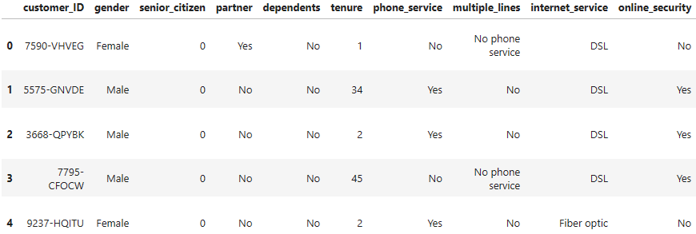
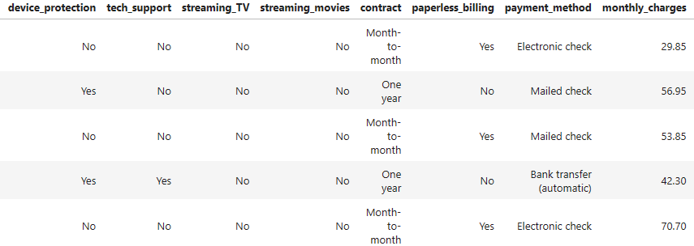
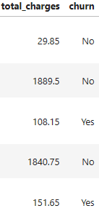
Dataset
7,043 rows, 21 columns
Account info
Demographic info
Service subscriptions
Customer attrition “churn”
Notes:
Rachael: Our raw data is comprised of 21 columns and about 7000 rows with customer:
Account information such as tenure, contract length, payment method, paperless billing, monthly charges, and total charges
Demographic info.including gender, age range, and if they have partners and dependents
8 different service subscriptions
Customer attrition/churn- customers who left within the last month

Slide 6



Preprocessing and Feature Engineering
Handling missing values
Dropped ‘customer_ID’
Replaced missing ‘total_charges’ with mean
Encoding categorical variables
Label encoding for binary
One-Hot-Encoding for more than two.
Creating new features
‘Service_count’
Data Scaling
Scikit-learn
Notes:
Rachael: We used Pandas to identify and handle any gaps in our dataset and dropped unnecessary columns like 'customer_ID' for a more focused analysis. We replaced 11 missing values in the 'total_charges' column with the mean, to ensure that our dataset was complete. And because machine learning models require numerical inputs, we used Label Encoding to convert binary variables like 'gender' and 'churn'.
For categorical variables with more than two options, we employed One-Hot Encoding to create binary columns for each category. This increased our dataset to 47 columns. We engineered a new feature called 'service_count'. This represents the count of services each customer has subscribed to, providing a consolidated view of their service engagement.
And finally, to bring consistency to our numeric features, we applied Standard Scaling to ensure that all our features are on a similar scale, preventing any particular feature from dominating the model.

Slide 7
Machine Learning Model Training
Choosing the Best Model
Notes:
Rachael Once our dataset was ready for model training, we split it into training and testing sets, paving the way for our machine learning model.

Slide 8
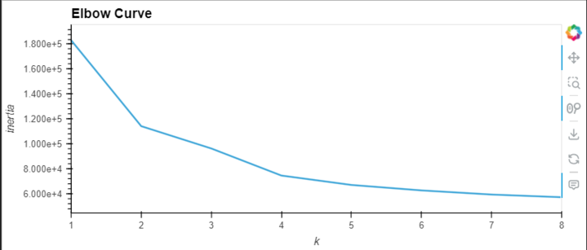
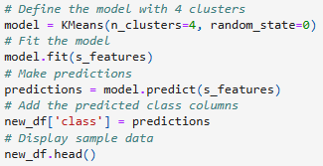
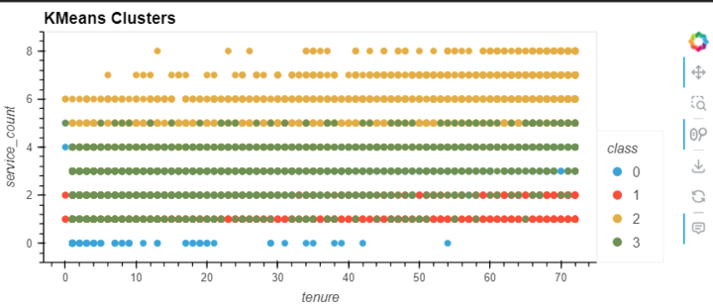
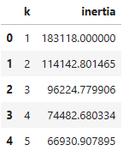
K Means Clustering
Notes:
Rachael We used KMeans clustering to group customers based on their service usage patterns. The elbow method helped us determine the optimal number of clusters (4), leading to more targeted customer segmentation. The objective was to uncover natural groupings and understand how different groups may exhibit varying levels of churn.
A scatter plot was created to visualize the clusters based on 'tenure' and 'service_count'. We didn’t see a clear, direct link between the two after plotting the groups. This lack of correlation prompted us to explore additional features and data to gain a more comprehensive understanding of customer behavior.
Our next steps involved diving deeper into the data to identify other factors that might influence customer attrition.

Slide 9
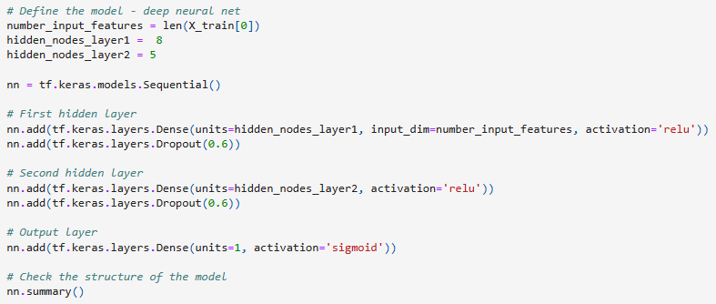


Neural Networking
Trial 1: Accuracy 0.735
Trial 2: Accuracy 1.0 (overfitting)
Trial 3: Accuracy 0.958
Notes:
Rachael For predicting customer churn, we built a neural network using TensorFlow/Keras. When we initially trained the neural network without any clustering, the model achieved an accuracy score of 0.735; however, after performing KMeans clustering on the "features" data and retraining the neural network, the model performed with perfect accuracy of (1.0). This raised concerns about overfitting, so to address this, dropout layers were added to create noise in our data and the number of training epochs was reduced from 100 to 20.
With these adjustments, our model generated an accuracy score of 0.958. We then fine-tuned our code by exploring various hyperparameter combinations using KarasTuner's search algorithms, allowing us to identify the most optimal configuration for maximizing predictive performance. The 10 best trials had an average of 0.979 accuracy. And now Benny will tell you more about our Model Evaluation metrics.

Slide 10
Model Evaluation Metrics
Assessing Model Performance
Notes:
Benny

Slide 11

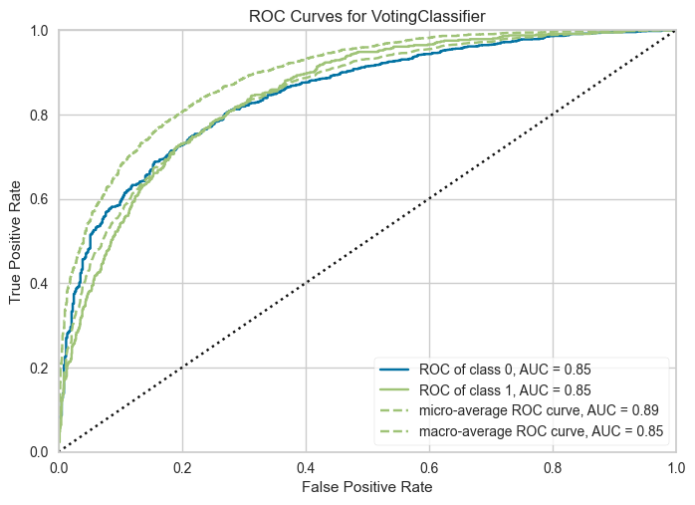
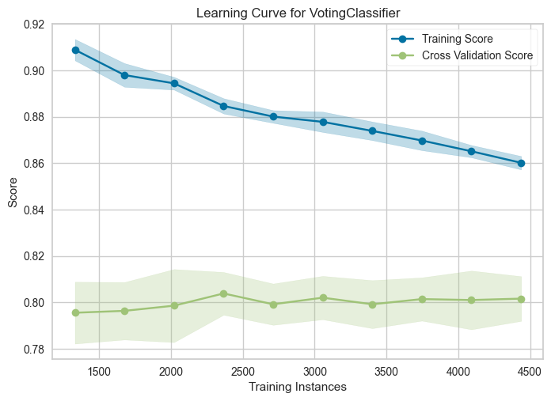
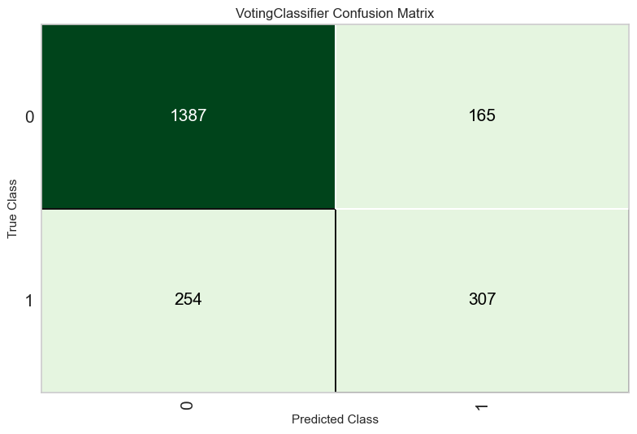
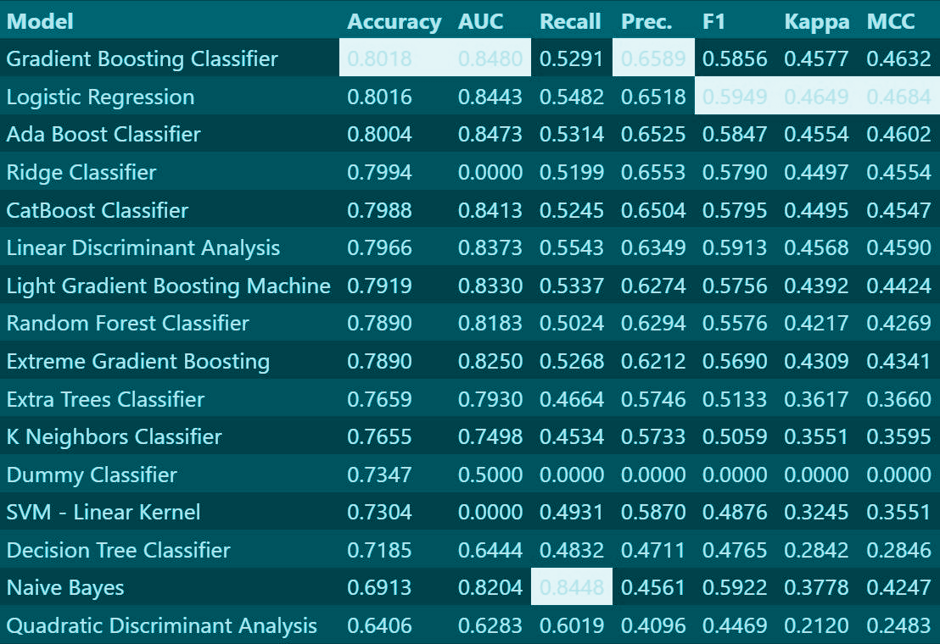
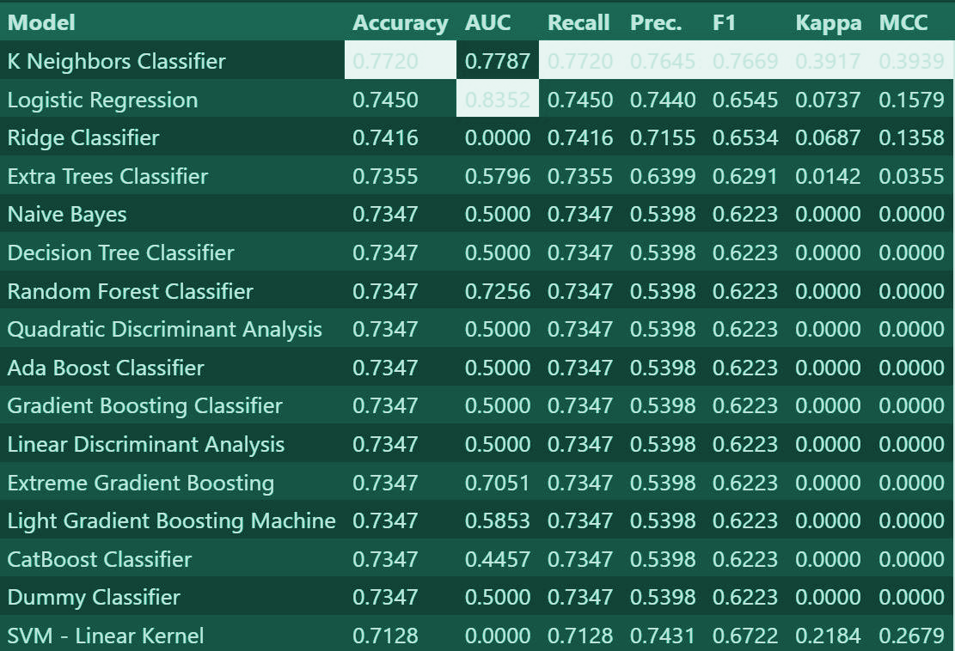
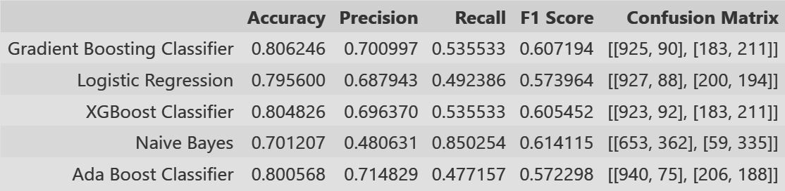
Notes:
Benny

Slide 12
Infrastructure Setup with Terraform
Deploy and Utilize the Model
Notes:
Benny

Slide 13
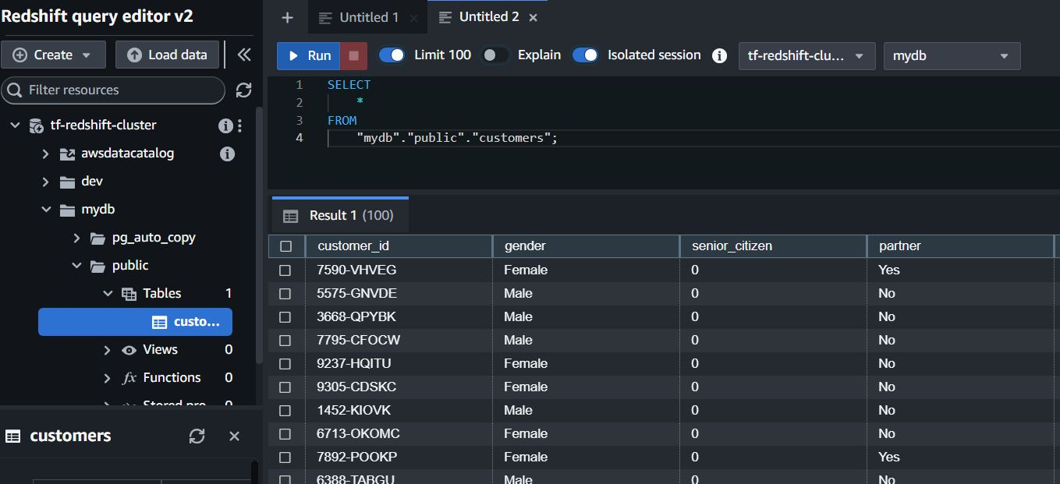

resource "aws_s3_bucket" "redshift_bucket" {
bucket = "redshift-bucket-project-4"
tags = {
Name = "Redshift Bucket"
Environment = "Dev"
}
}
resource "aws_redshift_cluster" "redshift_cluster" {
cluster_identifier = "tf-redshift-cluster"
database_name = "mydb"
master_username = "admin"
master_password = random_password.password.result
node_type = "dc2.large"
cluster_type = "single-node"
skip_final_snapshot = true
Cluster
iam_roles = [aws_iam_role.redshift_iam_role.arn]
}
resource "aws_iam_role" "redshift_iam_role" {
name = "redshift-s3-role"
assume_role_policy = jsonencode({
Version = "2012-10-17",
Statement = [
{
Action = "sts:AssumeRole",
Effect = "Allow",
Principal = {
Service = "redshift.amazonaws.com"
}
Notes:
Benny We opted for Terraform to manage our infrastructure. It provides a declarative approach, allowing us to define and provision our infrastructure efficiently.

Slide 14




Docker & Flask Api
Route “ / “ Query Redshift Jsonify data Return results
Route “/generate” Generate data Make predictions Return results
Notes:
Benny

Slide 15
Interactive Visualization
HTML/CSS Integration
Notes:
Michelle So now that we have cleaned our data, explored our data, and modeled our data, we are ready to display our findings and tell our story. We decided to use a one page website and create a dashboard displaying our most prominent visualizations and information.

Slide 16
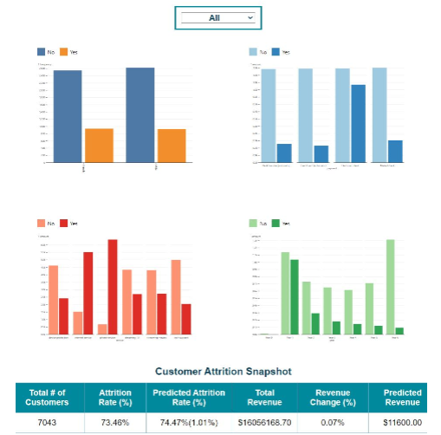
Data Website
Dropdown showing visualizations by Contract Length
Using plotly/D3, we compared various items to Attrition
Created a table showing our results and conclusions
Notes:
Michelle We used JavaScript Plotly and D3 to create the visualizations, and we used HTML and Cascading Style Sheets to display them in a dashboard single page website. We wanted to add an interactive element, so we created a drop-down menu based on contract type, to let users determine if they wanted to see all customers, or just customers with month to month, 1, or 2 year contracts. We thought that would add an additional layer to the charts and visualizations. DEMO WEBSITE NOW

Slide 17

Conclusion
and Next Steps
Recap and Future Recommendations
Notes:
Michelle Once we were able to view the different charts and finished analyzing our data, we wanted to come up with recommendations for What the Buddha’s marketing team, so that they could grow and decrease attrition.

Slide 18
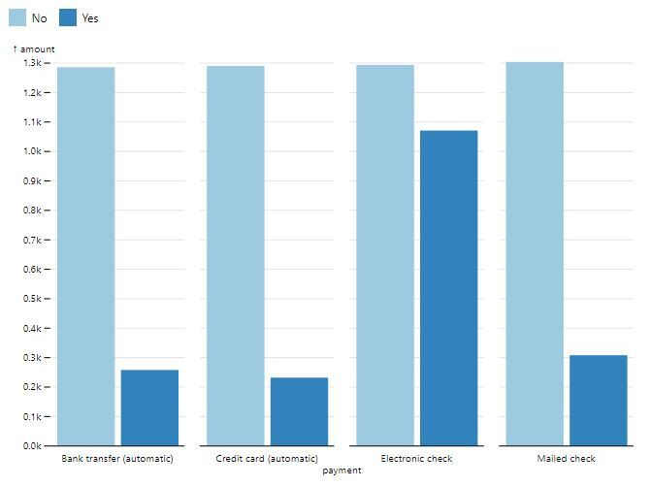
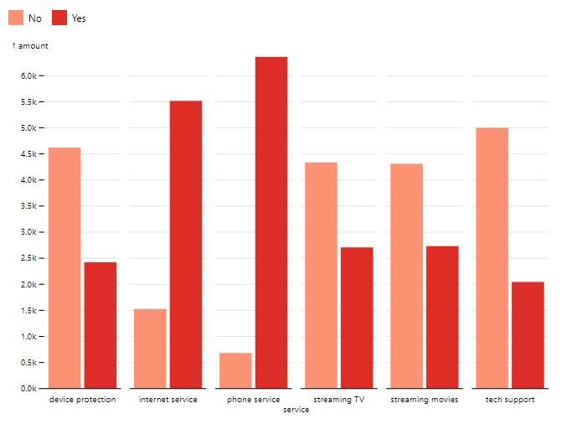

Oh My Buddha Sale!
Tv and Phone Service
high attrition rate
Device Protection and Tech Support
low attrition rate
Possible discount for automatic draft/payments
Notes:
Michelle We noticed that, while we weren’t able to correlate the amount of items a customer had with Attrition, we were able to see that there were a few items that clearly had more attrition, and a few that had significantly less. Internet Service and TV Service had the highest rate of negative Attrition vs Positive, while Tech Support and Device Protection had the opposite, so it made sense to bundle those together. We are recommending a bundle deal with TV and/or Internet Service and Tech Support and/or Device Protection. We also noticed that automatic drafts or payments had a much higher Positive Attrition, so we would suggest applying a discount for those that sign up for that.

Slide 19
Thanks!
What questions do you have?

